Slide 1

Quantifying the ambient population
Annabel Whipp
PhD candidate
Leeds Institute for Data Analytics and the School of Geography

Slide 2

Defining the ambient population

Slide 3
Applications of the project
Emergency planning and risk management
Pollution exposure
More accurate representations of transport usage
Destination popularity
Urban dynamics: how the populations fluctuate and how they interact with the built environment

Slide 5
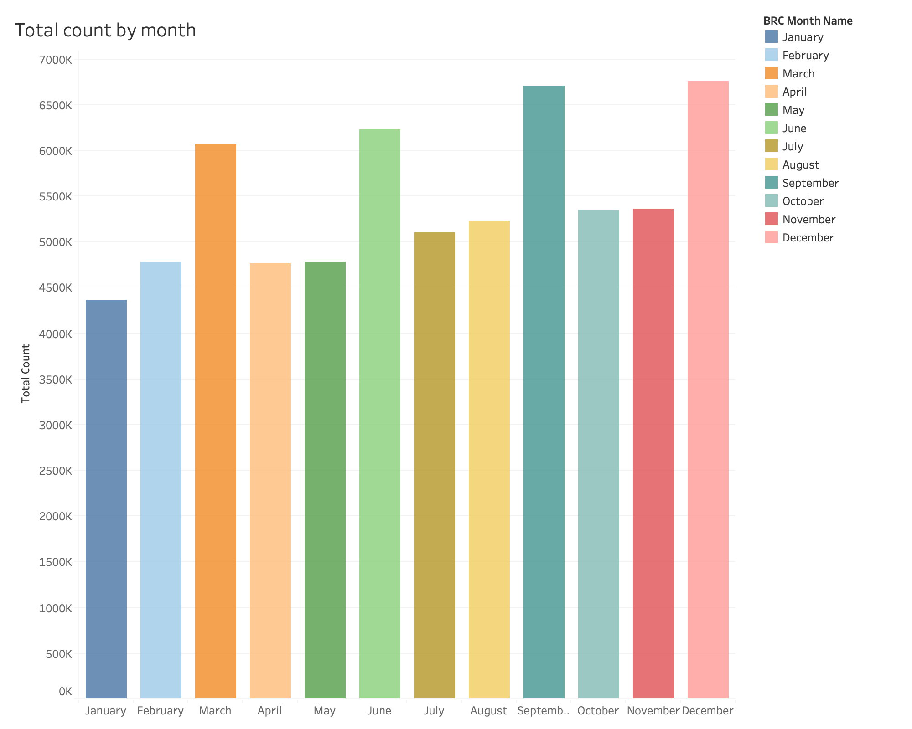
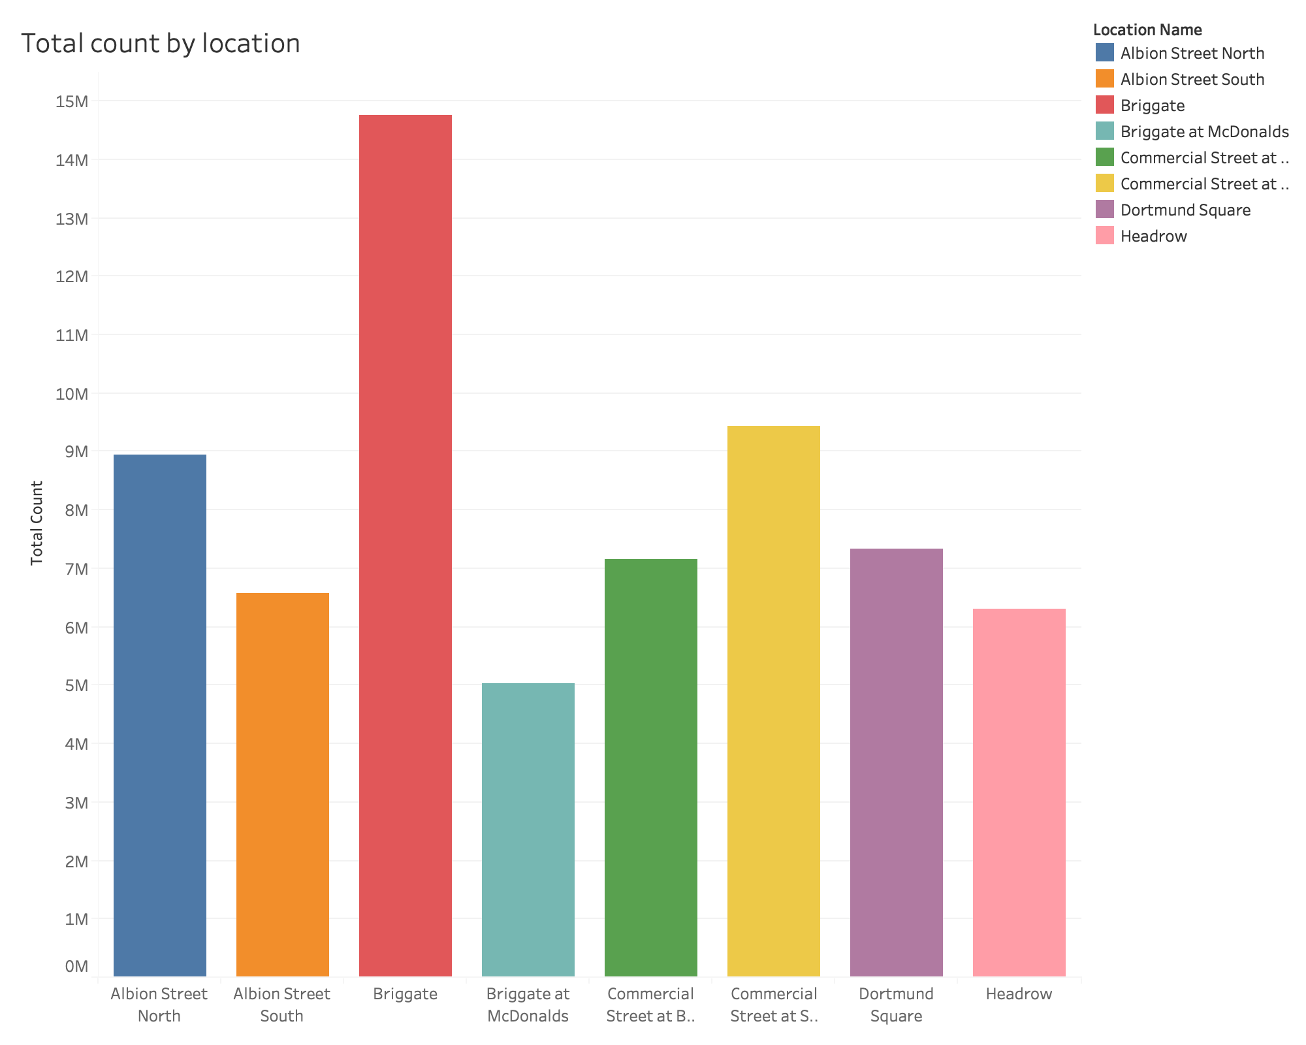
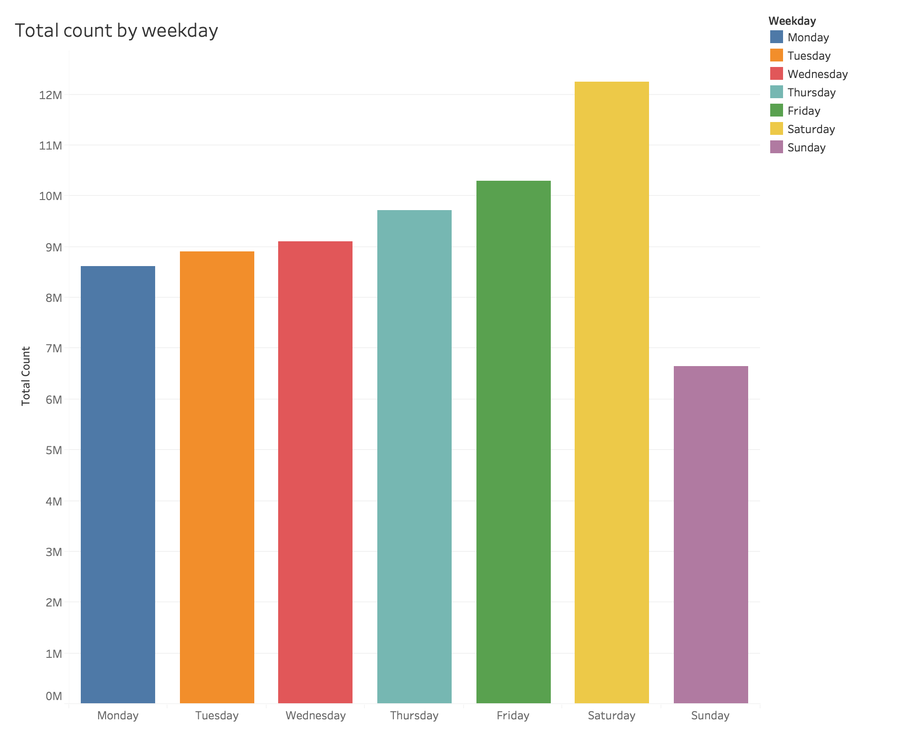
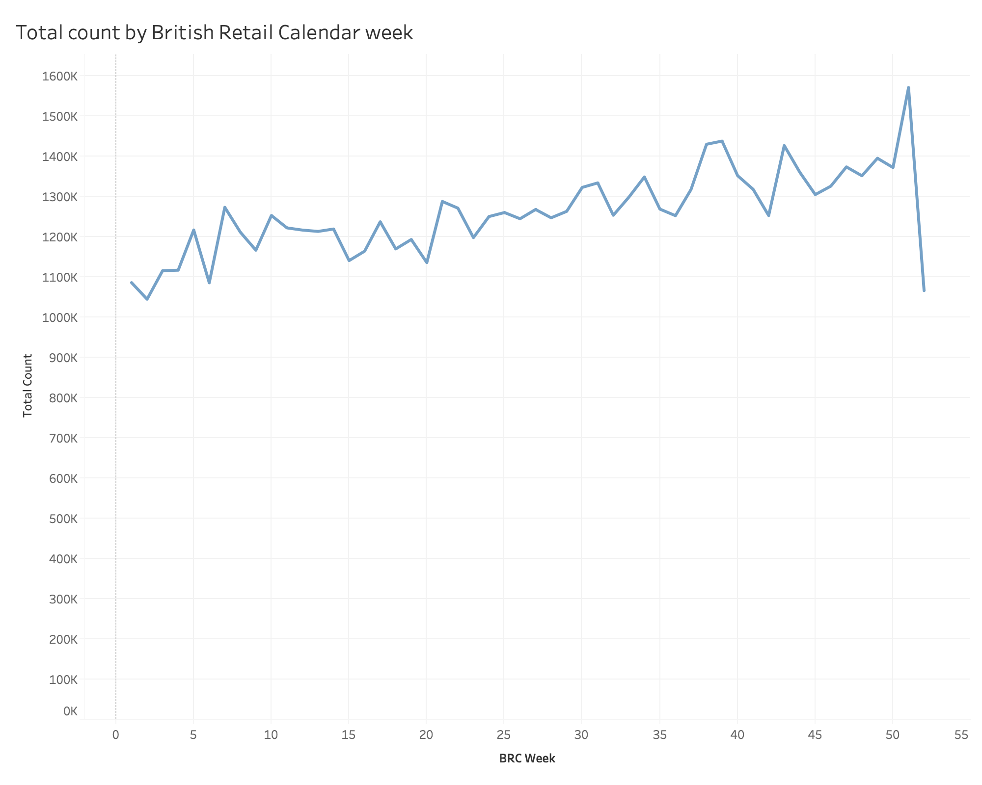
Identifying spatio-temporal trends

Slide 6
Temporal trends: 2016-2017
01:00
02:00-05:00
11:00-15:00
06:00-10:00
16:00-00:00
No change
Decrease
Increase

Slide 7
Data fusion
Combine footfall camera data with other sources, such as:
Wi-Fi sensors
Car park usage
Park and Ride usage
Train station concourse footfall data
Travel information
Geo-located social media posts

Slide 8



Annabel Whipp
PhD candidate
Leeds Institute for Data Analytics/School of Geography
Email: gy14aw@leeds.ac.uk
Twitter: @annabelelizabethwhipp
Questions

